Slide 1

*GCP* Google Marketing Platform
Present by- Ashutosh Bhanawat

Slide 2
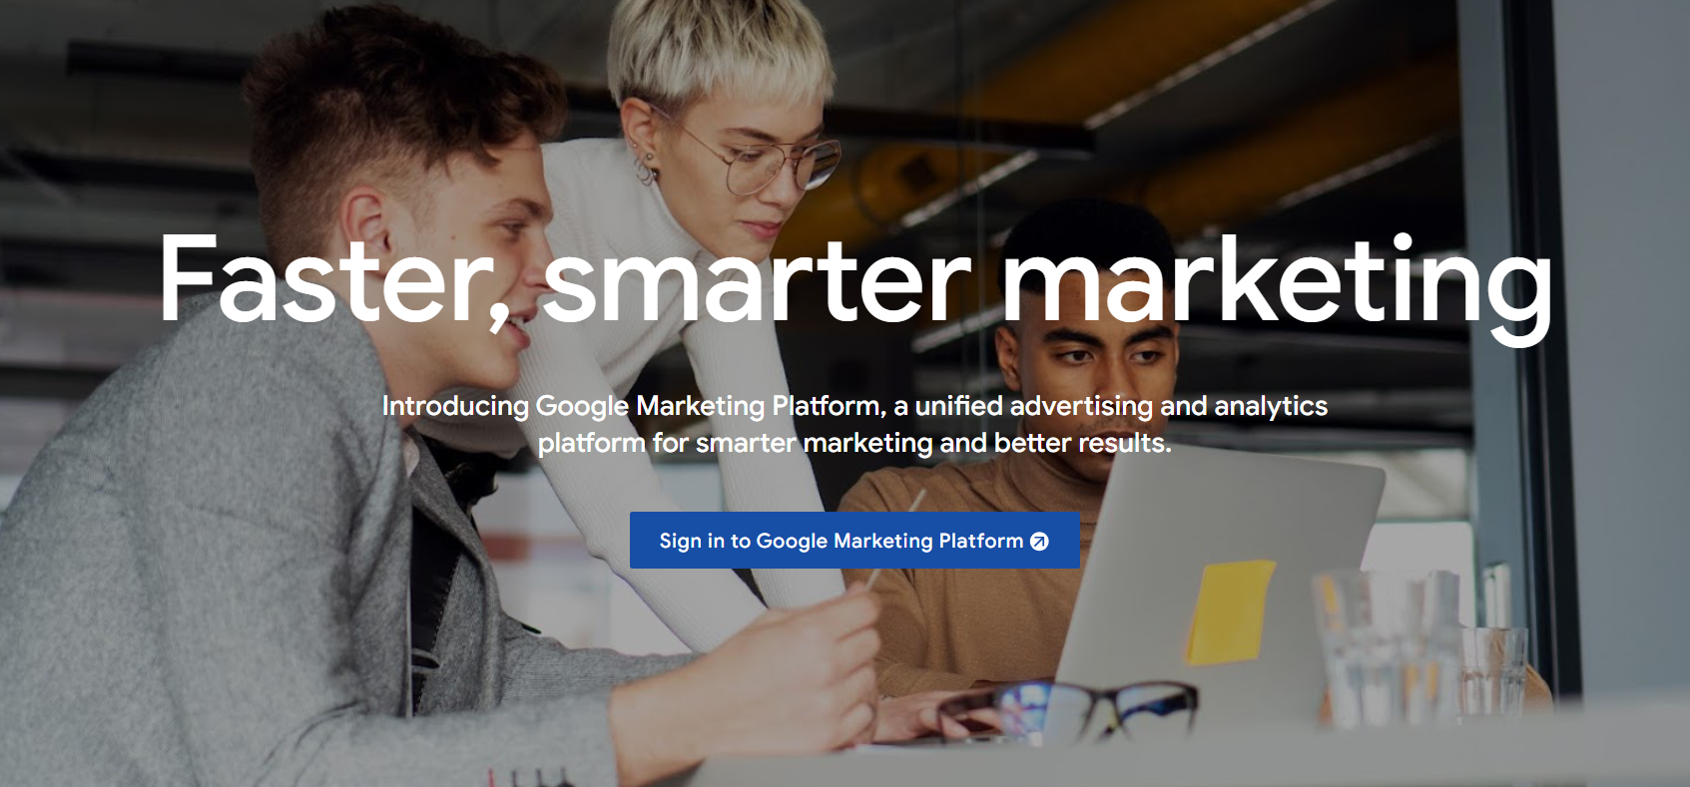
What is Google Marketing Platform?
Google Marketing Platform is a unified marketing and analytics platform that helps businesses measure and optimize their marketing efforts. It provides a suite of tools for advertising, analytics, and marketing attribution, allowing businesses to make data-driven decisions and improve their marketing

Slide 3
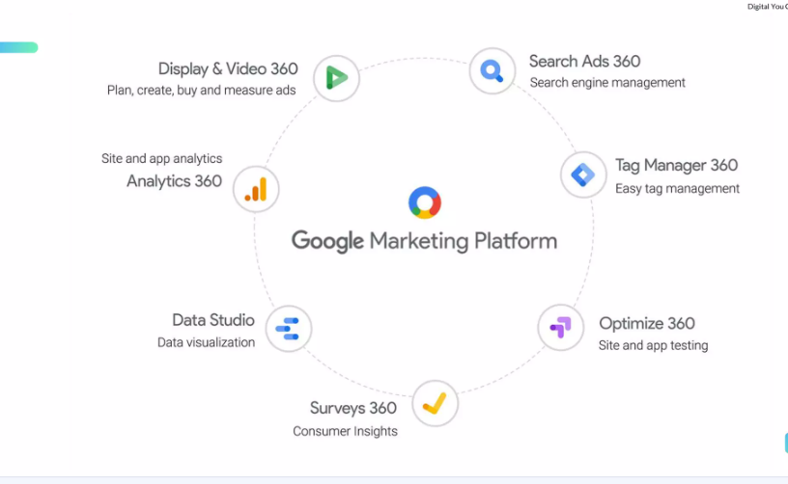

Slide 4
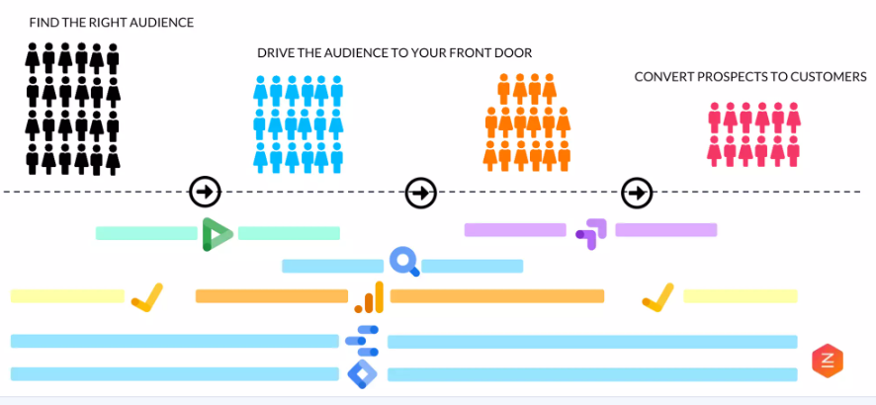

Slide 5
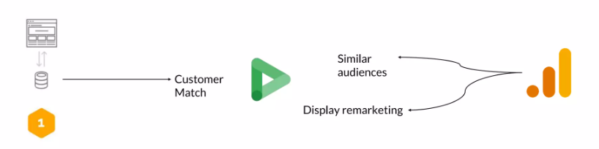
Display & Video 360
What is it?: A demand-side platform (DSP) for buying, managing, and optimizing digital display and video ads across multiple exchanges and networks.
Key Features:
Advanced targeting capabilities, including audience targeting, contextual targeting, and lookalike targeting
Real-time bidding and optimization for maximum ROI
Integration with Google Analytics 360 for measurement and attribution
Support for multiple ad formats, including display, video, native, and mobile
Benefits:
Improved ad targeting and reach
Increased efficiency and reduced waste
Better measurement and attribution of display and video ads

Slide 6
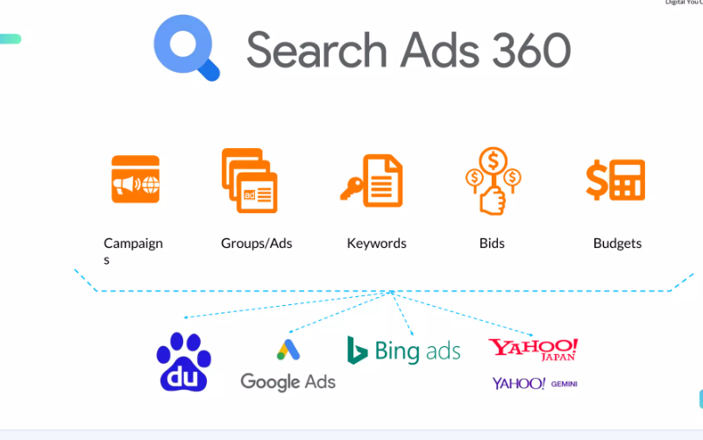
Search Ads 360
What is it?: A search management platform for managing and optimizing search advertising campaigns across multiple engines, including Google Ads, Bing Ads, and Yahoo Gemini.
Key Features:
Advanced bidding and optimization capabilities, including automated bidding and custom bidding strategies
Integration with Google Analytics 360 for measurement and attribution
Support for multiple search engines and ad formats, including text ads, shopping ads, and video ads
Advanced reporting and analytics capabilities
Benefits:
Improved search advertising performance and ROI
Increased efficiency and reduced waste
Better measurement and attribution of
search advertising campaigns

Slide 7
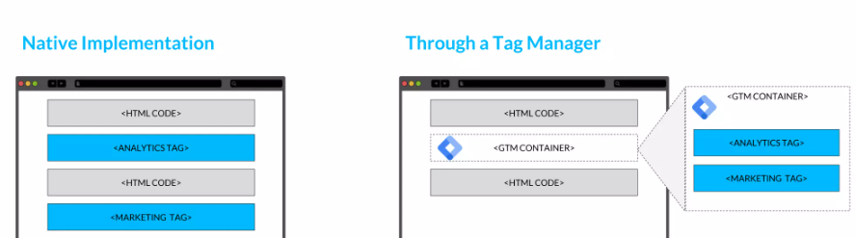
Tag Manager 360
What is it?: A tag management system for tracking website interactions and events, and deploying marketing and analytics tags across websites and apps.
Key Features:
Easy deployment of tracking and marketing tags across websites and apps
Integration with Google Analytics 360 for advanced analytics and measurement
Support for multiple tag types, including Google Ads, Facebook, and custom tags
Advanced trigger and variable capabilities for customizing tag behavior
Benefits:
Simplified tag management and deployment
Improved data quality and accuracy
Increased efficiency and reduced waste

Slide 8
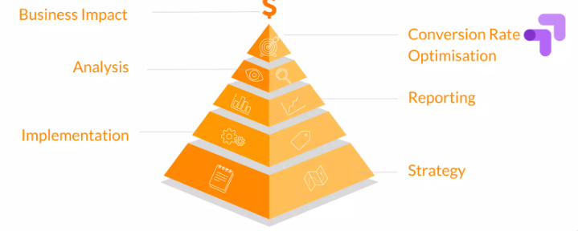
Optimize 360
What is it?: A website optimization and personalization platform for improving website experiences and conversion rates.
Key Features:
Advanced A/B testing and multivariate testing capabilities
Integration with Google Analytics 360 for measurement and attribution
Support for multiple testing and personalization scenarios, including page-level, element-level, and user-level testing
Advanced reporting and analytics capabilities
Benefits:
Improved website experiences and conversion rates
Increased revenue and ROI
Better measurement and attribution of website optimization efforts

Slide 9
Surveys 360
What is it?: A survey and feedback platform for collecting and analyzing customer feedback and opinions.
Key Features:
Advanced survey design and deployment capabilities
Integration with Google Analytics 360 for measurement and attribution
Support for multiple survey formats, including online, mobile, and offline surveys
Advanced reporting and analytics capabilities
Benefits:
Improved customer insights and feedback
Increased customer satisfaction and loyalty
Better measurement and attribution of customer feedback efforts

Slide 10
Data Studio
What is it?: A data visualization and reporting platform for creating interactive, web-based dashboards and reports.
Key Features:
Advanced data visualization capabilities, including charts, tables, and maps
Integration with multiple data sources, including Google Analytics 360, Google Ads, and Google Sheets
Support for multiple report formats, including dashboards, reports, and datasets
Advanced collaboration and sharing capabilities
Benefits:
Improved data visualization and reporting
Increased efficiency and reduced waste
Better measurement and attribution of marketing efforts

Slide 11
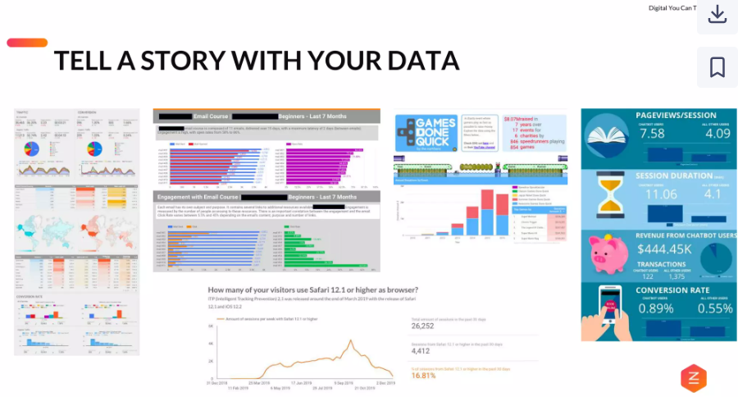

Slide 12
Analytics 360
What is it?: A powerful analytics tool for measuring website and app traffic, engagement, and conversion.
Key Features:
Advanced analytics capabilities, including data-driven attribution and predictive analytics
Integration with other Google Marketing Platform tools, such as Google Ads and Google Tag Manager
Support for multiple data collection methods, including page tags, event tracking, and data import
Advanced reporting and analytics capabilities
Benefits:
Improved measurement and attribution of marketing efforts
Increased efficiency and reduced waste
Better data-driven decision making

Slide 13
